Slide 1

Sequences
Yr12 apps
Sadler ch3 and 4

Slide 2
Contents
Lesson 1: Sequences
Lesson 2: Terms of a sequence
Lesson 3: Recursive rules
Lesson 4: Arithmetic Sequences
Lesson 5: Geometric Sequences
Lesson 6: Growth and decay
Lesson 7: Steady state

Slide 3
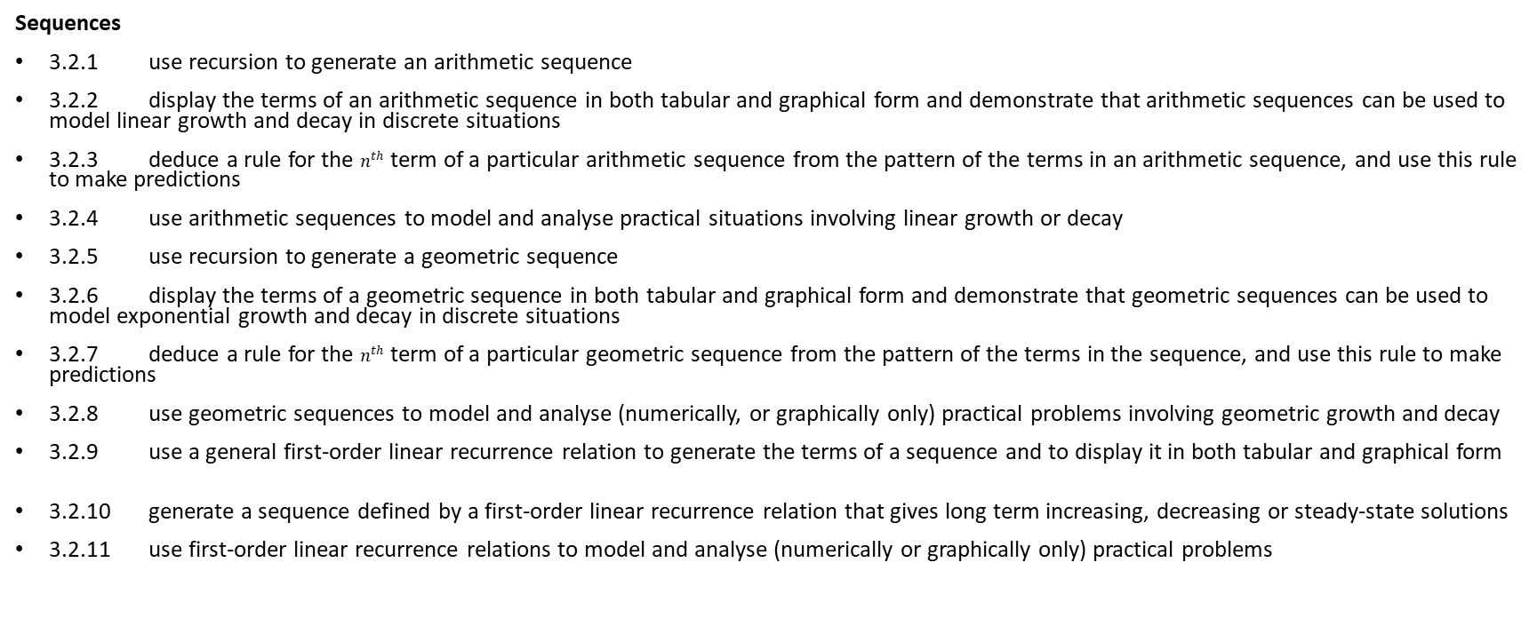
Syllabus
Sequences
3.2.1 use recursion to generate an arithmetic sequence
3.2.2 display the terms of an arithmetic sequence in both tabular and graphical form and demonstrate that arithmetic sequences can be used to model linear growth and decay in discrete situations
3.2.3 deduce a rule for the $n^{th}$ term of a particular arithmetic sequence from the pattern of the terms in an arithmetic sequence, and use this rule to make predictions
3.2.4 use arithmetic sequences to model and analyse practical situations involving linear growth or decay
3.2.5 use recursion to generate a geometric sequence
3.2.6 display the terms of a geometric sequence in both tabular and graphical form and demonstrate that geometric sequences can be used to model exponential growth and decay in discrete situations
3.2.7 deduce a rule for the $n^{th}$ term of a particular geometric sequence from the pattern of the terms in the sequence, and use this rule to make predictions
3.2.8 use geometric sequences to model and analyse (numerically, or graphically only) practical problems involving geometric growth and decay
3.2.9 use a general first-order linear recurrence relation to generate the terms of a sequence and to display it in both tabular and graphical form
3.2.10 generate a sequence defined by a first-order linear recurrence relation that gives long term increasing, decreasing or steady-state solutions
3.2.11 use first-order linear recurrence relations to model and analyse (numerically or graphically only) practical problems

Slide 4
Lesson 1
Contents
Topic: Sequences
EQ: What are sequences?

Slide 5
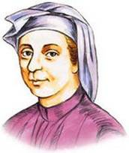
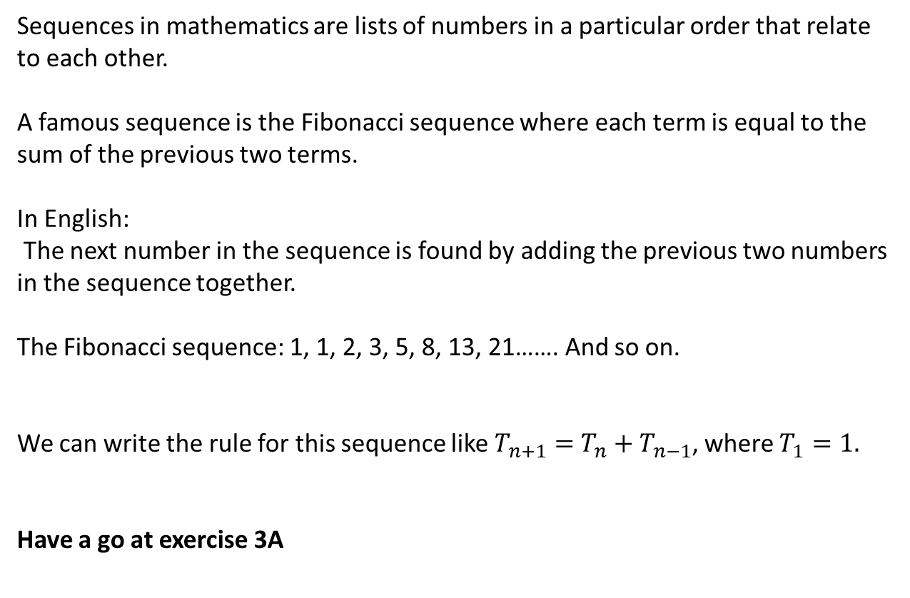
Topic: Sequences|
EQ: What are sequences?
Sequences in mathematics are lists of numbers in a particular order that relate to each other.
A famous sequence is the Fibonacci sequence where each term is equal to the sum of the previous two terms.
In English:
The next number in the sequence is found by adding the previous two numbers in the sequence together.
The Fibonacci sequence: 1, 1, 2, 3, 5, 8, 13, 21……. And so on.
We can write the rule for this sequence like $T_{n+1}=$ $T_{n}+T_{n−1}$, where $T_{1}=1.$
Have a go at exercise 3A
If you get bored, google image search Fibonacci in nature.
Fibonacci: also known as Leonardo Bonacci

Slide 6
Lesson 2
Contents
Topic: Terms of a Sequence
EQ: How do you know what a term in a sequence is?

Slide 7
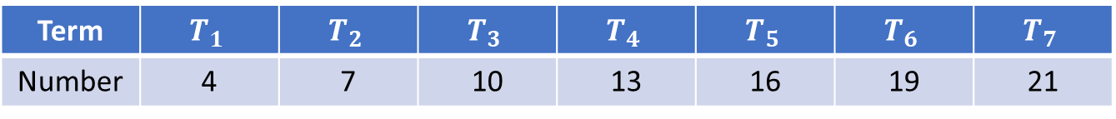
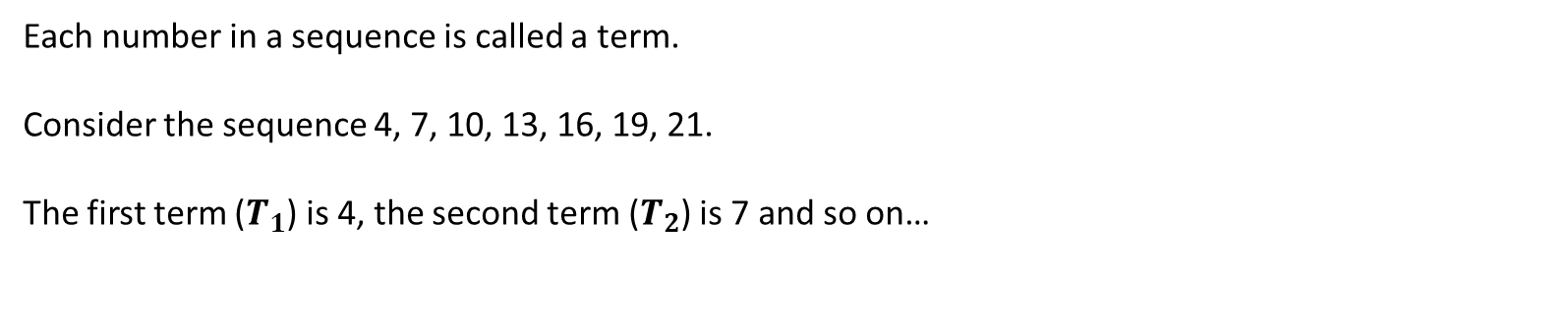
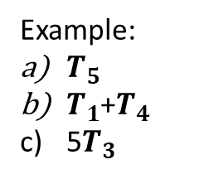
Topic: Terms of a Sequence
EQ: How do you know what a term in a sequence is?
Each number in a sequence is called a term.
Consider the sequence 4, 7, 10, 13, 16, 19, 21.
The first term ($T_{1}$) is 4, the second term ($T_{2}$) is 7 and so on…
Term | $$T_{1}$$ | $$T_{2}$$ | $$T_{3}$$ | $$T_{4}$$ | $$T_{5}$$ | $$T_{6}$$ | $$T_{7}$$
Number | 4 | 7 | 10 | 13 | 16 | 19 | 21
Example:
$T_{5}$
$T_{1}$+$T_{4}$
5$T_{3}$
Answers
16
4+13=17
5 x 10= 50
Complete Ex 3B

Slide 8
Lesson 3
Contents
Topic: Recursive rules
EQ: How can we write and use recursive rules?

Slide 9
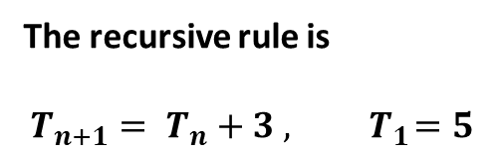
Topic: Recursive rules
EQ: How can we write and use recursive rules?
A recursive definition of a sequence states how to obtain the next term of a sequence given the previous term (or terms). You also need a marker, usually the first term (or terms).
Consider the sequence: 5, 8, 11, 14, 17, 20, 23,…
What is the pattern?
What is the first term?
In an exam this is worth 2 marks, 1 for the rule and 1 for stating the first term
It is going up by 3
5
The recursive rule is
$$T_{n+1}= T_{n}+3 , { T}_{1}=5$$
The next term is equal to the previous term plus 3, and the first term is 5

Slide 10
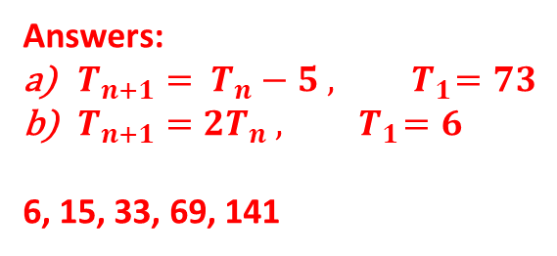
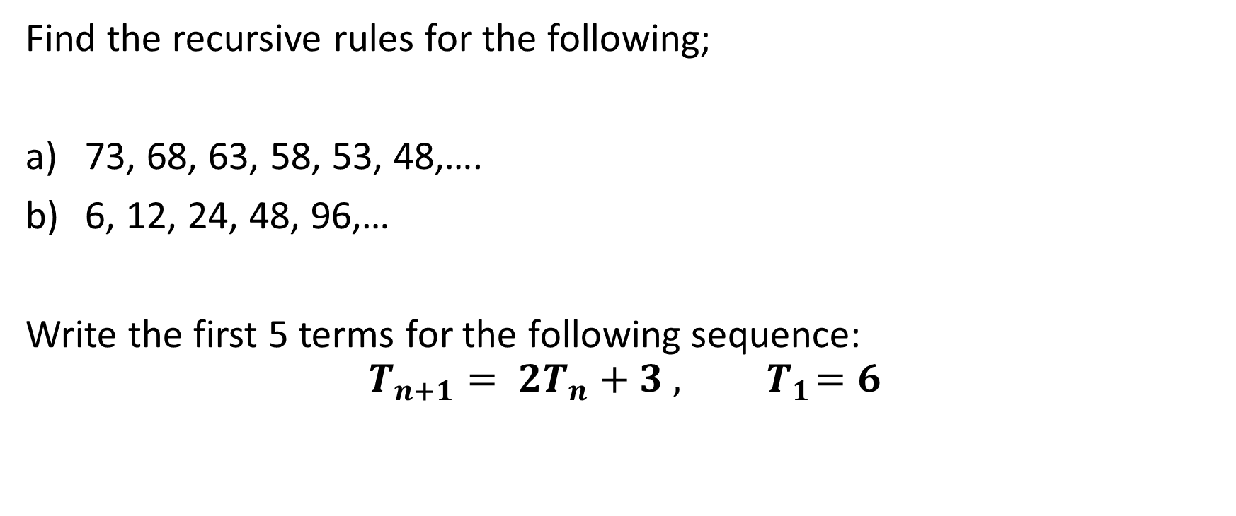
Try these please
Find the recursive rules for the following;
73, 68, 63, 58, 53, 48,….
6, 12, 24, 48, 96,…
Write the first 5 terms for the following sequence:
$$T_{n+1}= {2T}_{n}+3 , { T}_{1}=6$$
Answers:
$T_{n+1}= T_{n}−5 , { T}_{1}=73$
$T_{n+1}=2T_{n} , { T}_{1}=6$
6, 15, 33, 69, 141

Slide 11
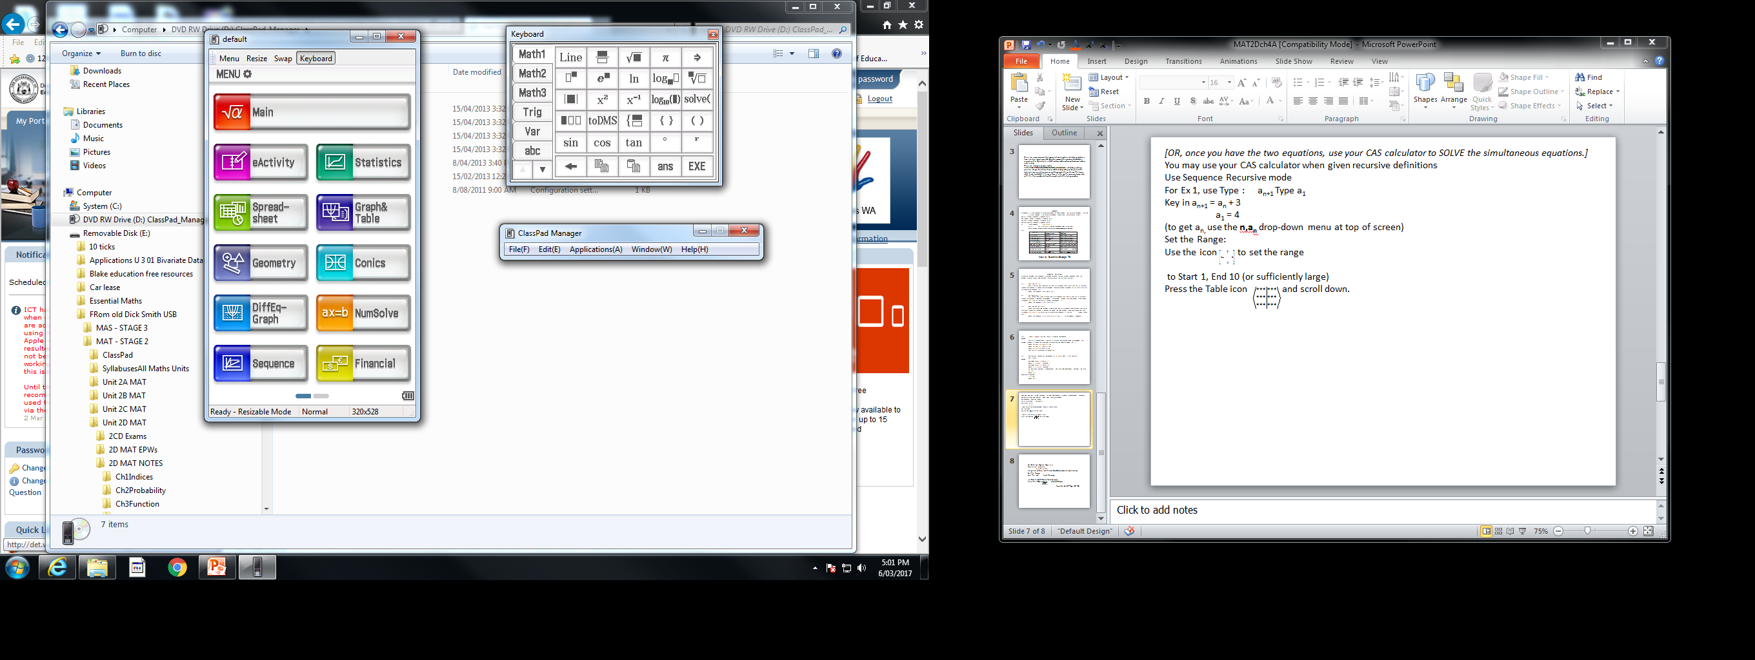
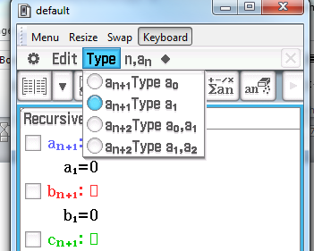
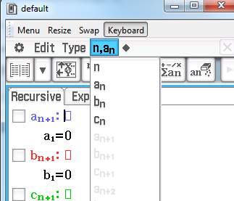
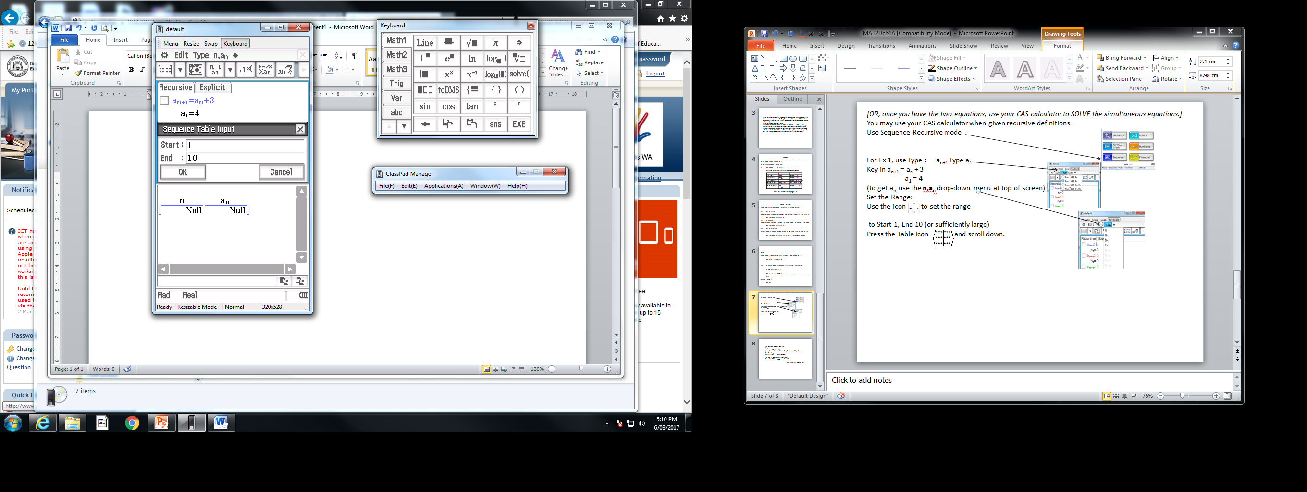
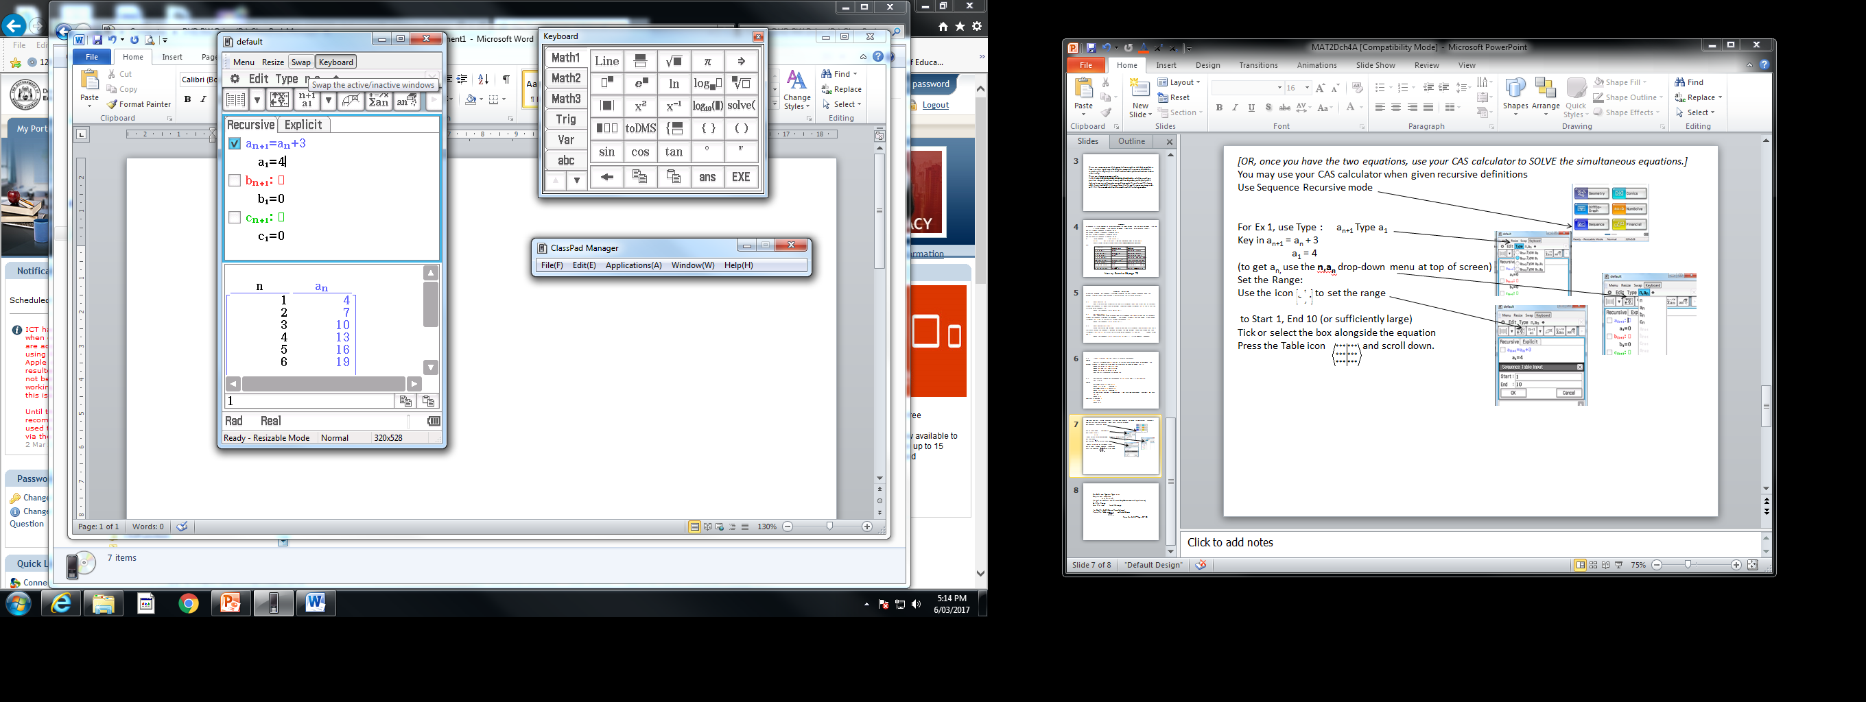
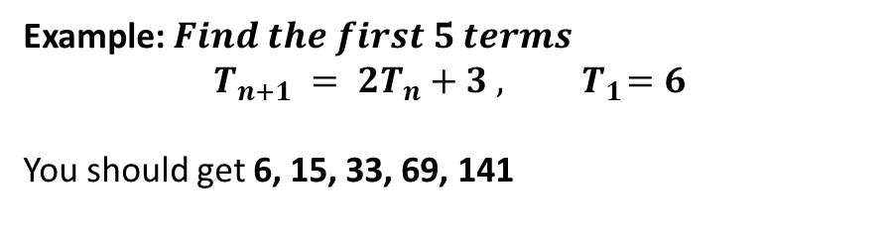
How to do this in your classpad
1. Open “Sequence”
2. Set the type
3. Use to type in the rule for the variables
4. Number of terms in the list
5. Type in your rule and click the table button to bring up your list
Example:${ Find the first 5 terms }_{}$
$$T_{n+1} = {2T}_{n}+3 , { T}_{1}=6$$
You should get 6, 15, 33, 69, 141

Slide 12
Complete exercise 3C please
1. Open “Sequence”
2. Set the type
3. Use to type in the rule for the variables
4. Number of terms in the list
5. Type in your rule and click the table button to bring up your list

Slide 13
Lesson 4
Contents
Topic: Arithmetic Sequences
EQ: What are Arithmetic sequences and how can we use them?

Slide 14
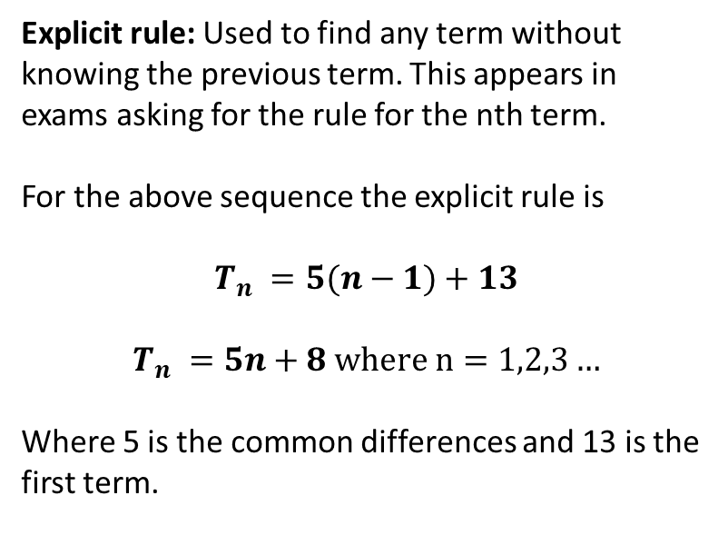
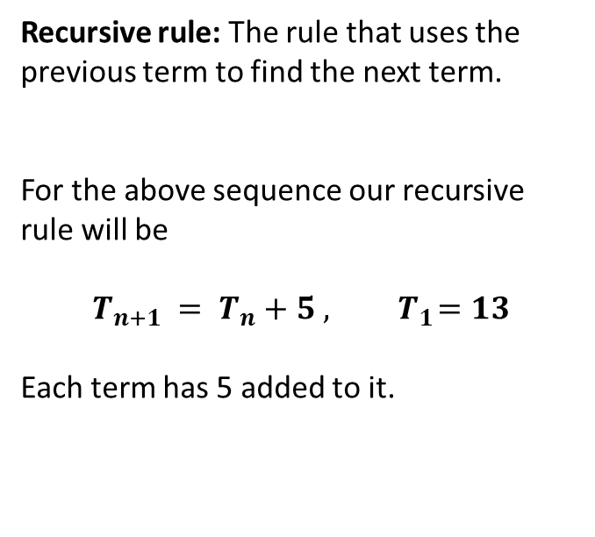
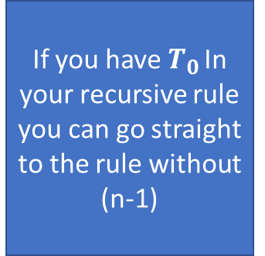
Topic: Arithmetic Sequences
EQ: What are Arithmetic sequences and how can we use them?
Arithmetic Sequences are formed by after the first term adding a constant amount to the previous term. This forms straight line when graphing them. They increase or decrease by the same amount.
Consider the sequence: 13, 18, 23, 28, 33, 38, …
Recursive rule: The rule that uses the previous term to find the next term.
For the above sequence our recursive rule will be
$$T_{n+1} = T_{n}+5 , { T}_{1}=13$$
Each term has 5 added to it.
Explicit rule: Used to find any term without knowing the previous term. This appears in exams asking for the rule for the nth term.
For the above sequence the explicit rule is
$$T_{n} =5(n−1)+13$$
$$T_{n} =5n+8 where n=1,2,3…$$
Where 5 is the common differences and 13 is the first term.
If you have $T_{0 }$In your recursive rule you can go straight to the rule without (n-1)
Recursive rule must have the rule and the first term to get full marks

Slide 15

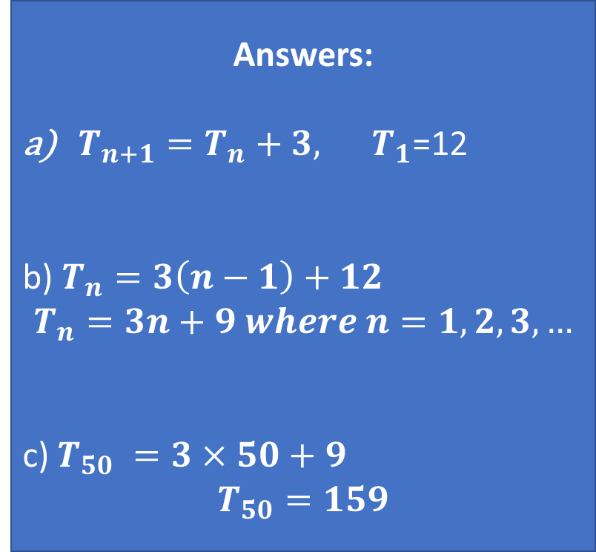
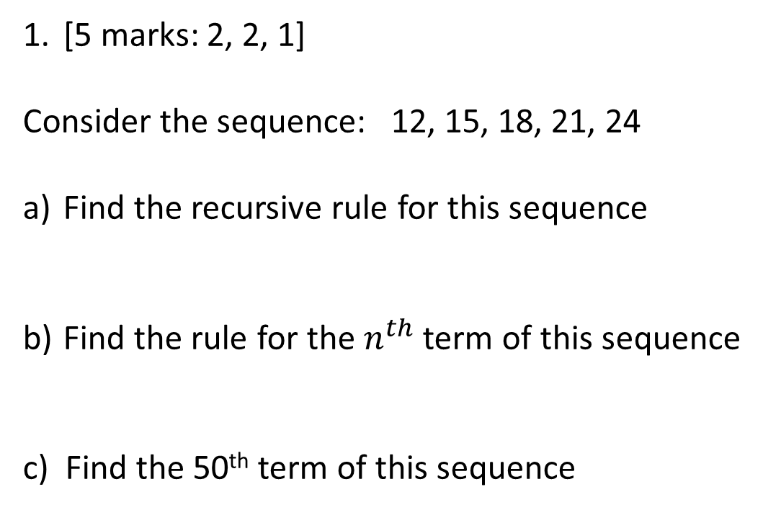
Exam Question: Calculator free
[5 marks: 2, 2, 1]
Consider the sequence: 12, 15, 18, 21, 24
Find the recursive rule for this sequence
Find the rule for the $n^{th}$ term of this sequence
c) Find the 50th term of this sequence
Answers:
$T_{n+1}=T_{n}+3, T_{1}$=12
b) $T_{n}=3\left(n−1\right)+12$ $$T_{n}=3n+9 where n=1,2,3,…$$
c) $T_{50} =3×50+9$ $$T_{50}=159$$

Slide 16
Complete ch5 in the ATP exam revision book
If you do not have this book with you work on Ch4A from the Sadler text

Slide 17
Lesson 5
Contents
Topic: Geometric Sequences
EQ: What are Geometric Sequences and how can we use them?

Slide 18
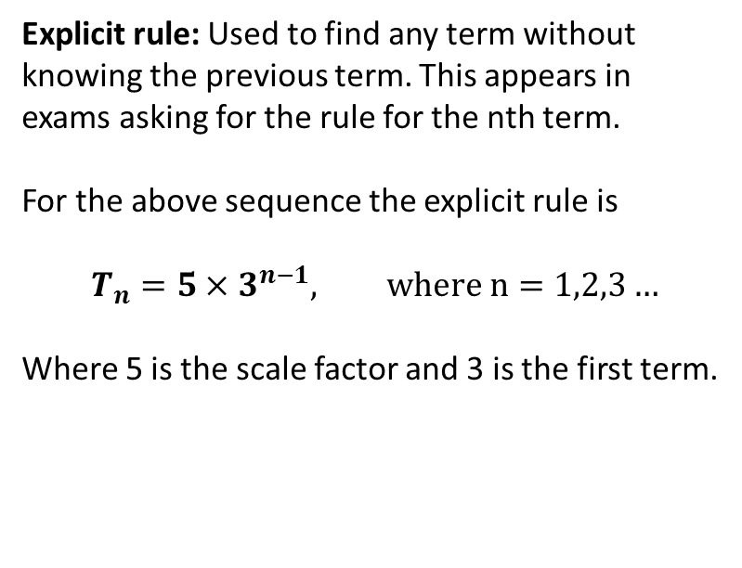
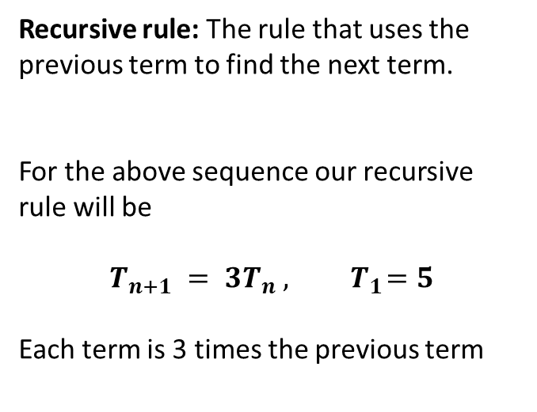
Topic: Geometric Sequences
EQ: What are Geometric sequences and how can we use them?
Geometric Sequences are found when we multiply the previous term by the same scale to find the next term.
This will for an exponential graph.
Consider the sequence: 5, 15, 45, 135…
Recursive rule: The rule that uses the previous term to find the next term.
For the above sequence our recursive rule will be
$$T_{n+1} = {3T}_{n} , { T}_{1}=5$$
Each term is 3 times the previous term
Explicit rule: Used to find any term without knowing the previous term. This appears in exams asking for the rule for the nth term.
For the above sequence the explicit rule is
$$T_{n}=5×3^{n−1}, where n=1,2,3…$$
Where 5 is the scale factor and 3 is the first term.
Recursive rule must have the rule and the first term to get full marks

Slide 19

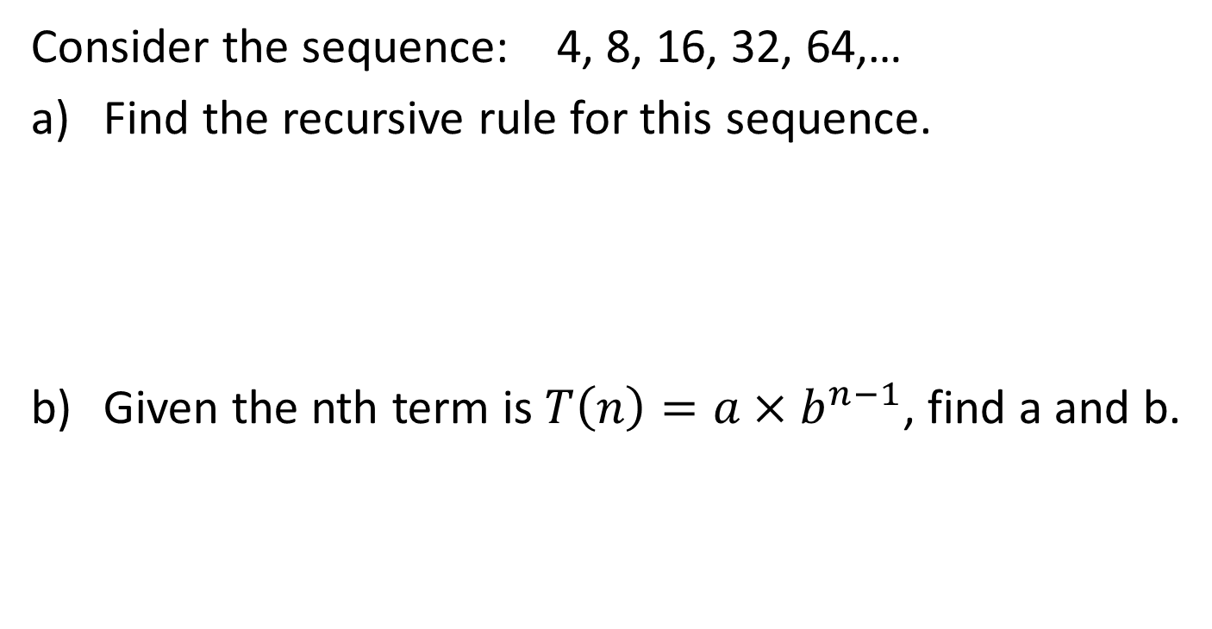
Example question:
Consider the sequence: 4, 8, 16, 32, 64,…
Find the recursive rule for this sequence.
Given the nth term is $T\left(n\right)=a×b^{n−1}$, find a and b.
$$T_{n+1}=2×T_{n}, { T}_{1}=4$$
$$T_{n}=4×2^{n−1}$$
$$∴a=4 and b=2$$

Slide 20
Complete this work.
ATF chapter 6
If you do not have this book with you finish off Ch4A from the Sadler text

Slide 21
Lesson 6
Contents
Topic: Growth and Decay
EQ: How can we represents growth and decay with sequences?

Slide 22
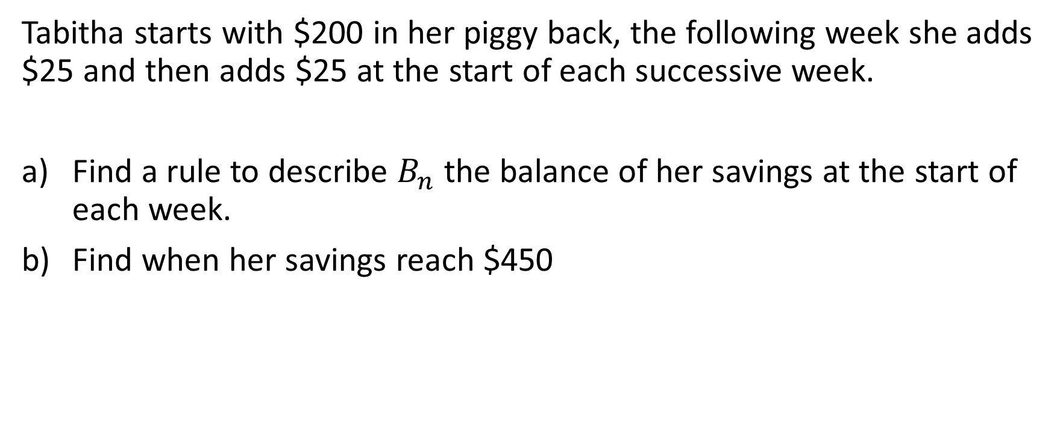
Starting problem
Tabitha starts with $200 in her piggy back, the following week she adds $25 and then adds $25 at the start of each successive week.
Find a rule to describe $B_{n}$ the balance of her savings at the start of each week.
Find when her savings reach $450

Slide 23
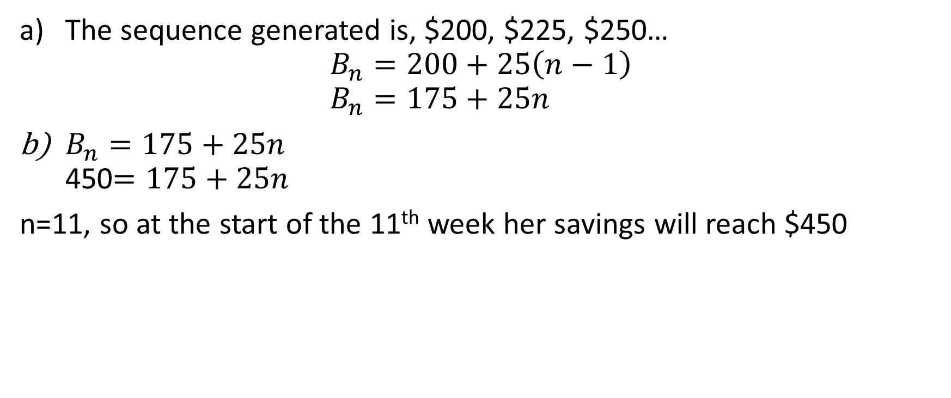
Solution
The sequence generated is, $200, $225, $250… $B_{n}=200+25\left(n−1\right)$ $B_{n}=175+25n$
$B_{n}=175+25n$ 450$=175+25n$
n=11, so at the start of the 11th week her savings will reach $450

Slide 24
Topic: Growth and Decay
EQ: How can we represents growth and decay with sequences?
All sequences can be seen as growth or decay. If they are increasing it is growth, if it is decreasing it is decay.
Arithmetic sequence = linear growth or decay
Geometric sequences = exponential growth or decay.
You can use spreadsheets, graphs or tables to show growth and decay.
This lesson is more about applying what you have already learnt into practical situations.

Slide 25
Complete Exercise 4B

Slide 26
Lesson 7
Contents
Topic: Steady State
EQ: How do we calculate and interpret long term steady state?

Slide 27
Introduction problem
A breeder of sheep has a breeding program produces a 20% increase in sheep each year. If the Breeder wants to sell 50 sheep at the end of each year, how many sheep will he need to have in his herd to maintain the same amount of sheep?
Answer: 250 sheep, because 20% of 250 is equal to 50, so the amount increases is equal to the amount taken away.

Slide 28
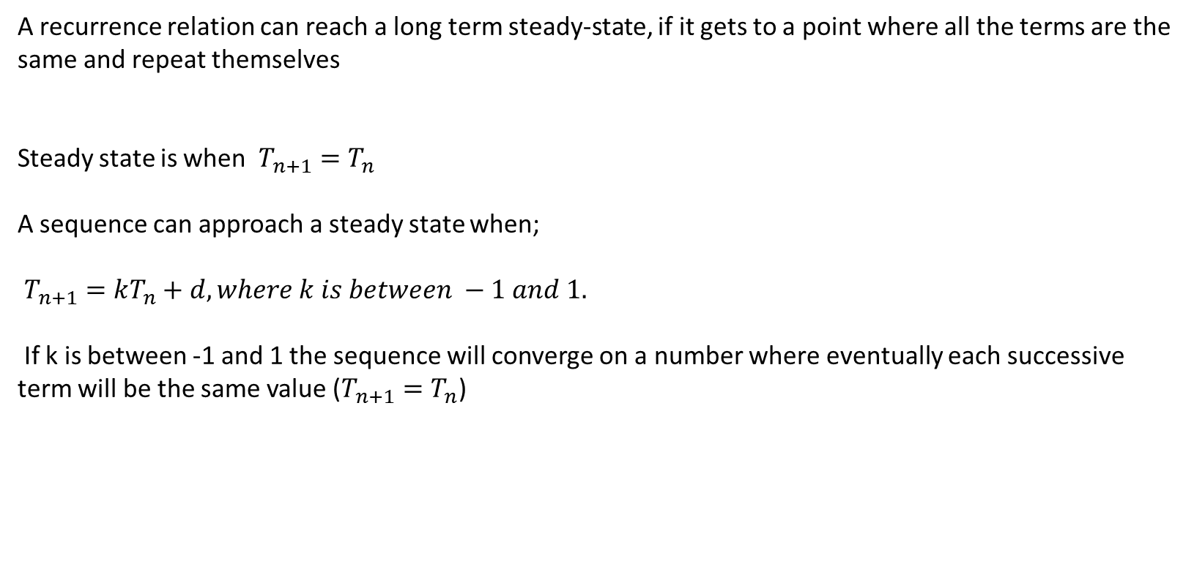
Topic: Steady State
EQ: How do we calculate and interpret long term steady state?
A recurrence relation can reach a long term steady-state, if it gets to a point where all the terms are the same and repeat themselves
Steady state is when $T_{n+1}=T_{n}$
A sequence can approach a steady state when;
$T_{n+1}=kT_{n}+d, where k is between −1 and 1.$
If k is between -1 and 1 the sequence will converge on a number where eventually each successive term will be the same value ($T_{n+1}=T_{n}$)

Slide 29
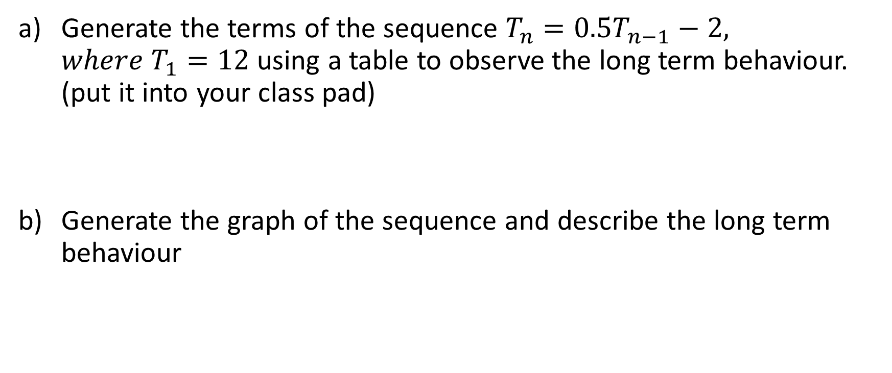
Example 1
Generate the terms of the sequence $T_{n}=0.5T_{n−1}−2, where T_{1}=12$ using a table to observe the long term behaviour. (put it into your class pad)
Generate the graph of the sequence and describe the long term behaviour

Slide 30
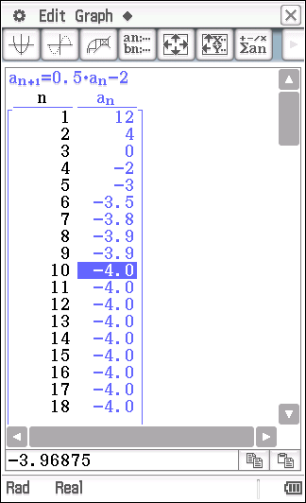
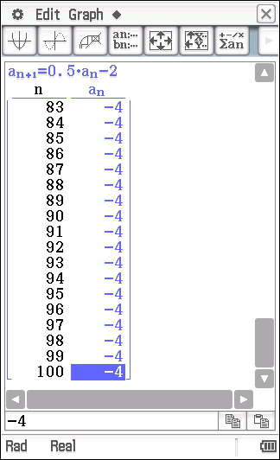
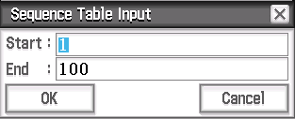
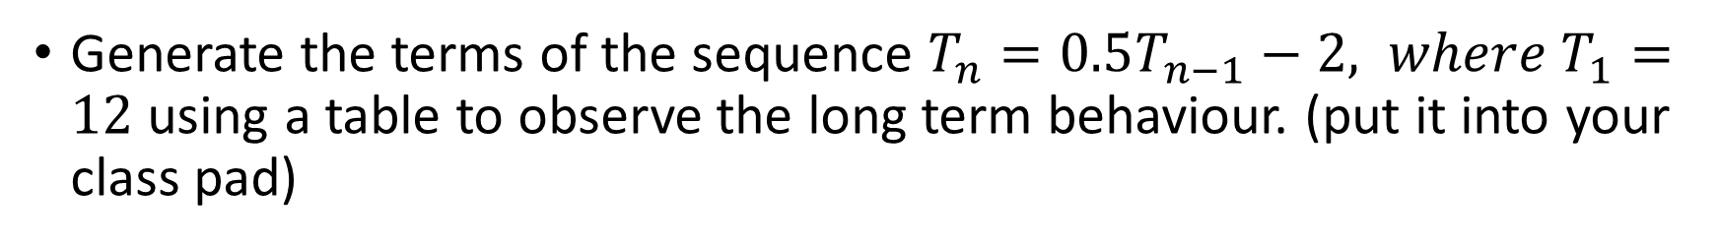
Generate the terms of the sequence $T_{n}=0.5T_{n−1}−2, where T_{1}=12$ using a table to observe the long term behaviour. (put it into your class pad)
The sequence appears to approach a steady-state value of -4

Slide 31
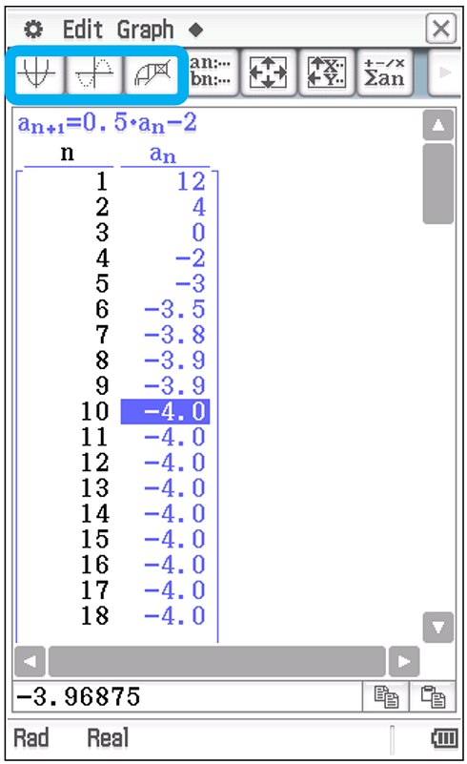
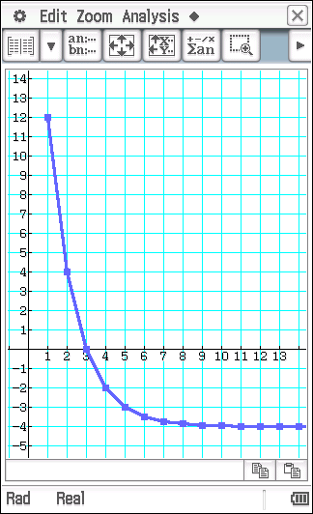
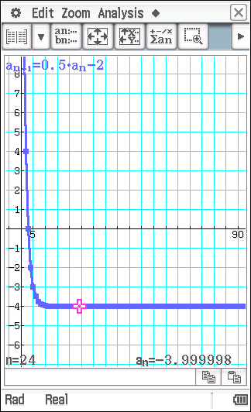
Generate the graph of the sequence and describe the long term behaviour
Zoom in
The sequence appears to approach a steady-state value of -4

Slide 32

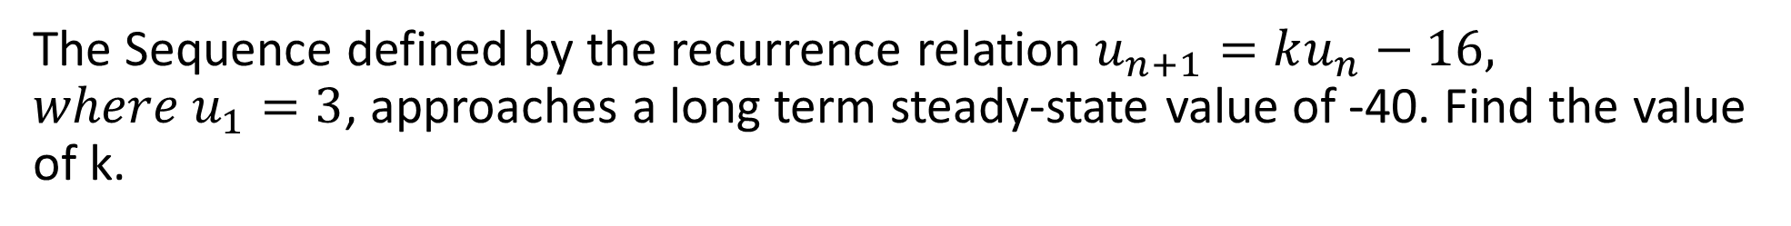
Example 2
The Sequence defined by the recurrence relation $u_{n+1}=ku_{n}−16, where u_{1}=3$, approaches a long term steady-state value of -40. Find the value of k.
$$u_{n+1}=ku_{n}−16 \\ −40=k×−40 −16 \\ −24=−40k \\ k=−\frac{24}{−40} \\ k=0.6$$
Substitute into recurrence relation
Solve for k

Slide 33
Complete the following
4C
Misc 4

